Slide 1
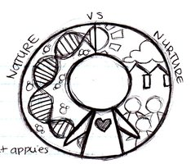
week 4 – Culture and Socialization

Slide 2
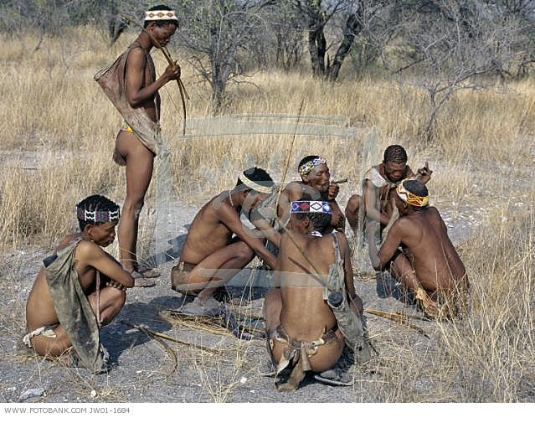
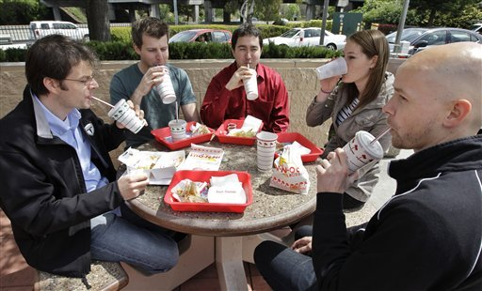
Cultural Universals

Slide 3
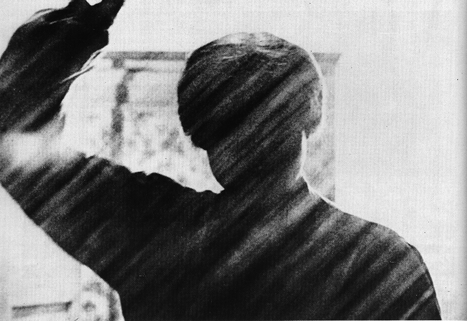
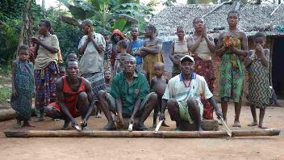
Universal: Music
United States
DR Congo
Egermann et al. 2015. “Music induces universal emotion-related psychophysiological responses:
comparing Canadian listeners to Congolese Pygmies.” Frontiers in Psychology.
doi: 10.3389/fpsyg.2014.01341

Slide 4


Universal: Marriage Ceremonies
United States
India

Slide 5
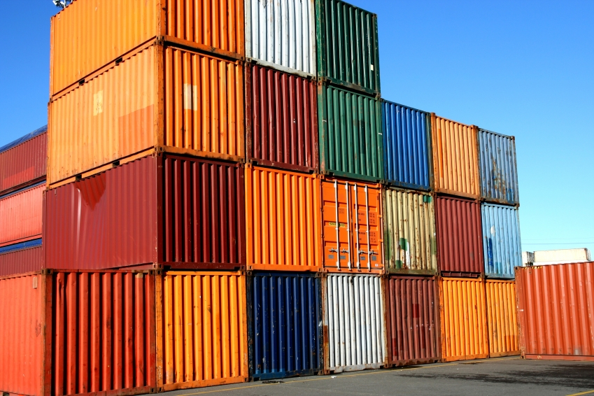
Culture around the World
Cultural Universals
Innovation
Discovery
Invention
Globalization
Diffusion
Technology

Slide 6
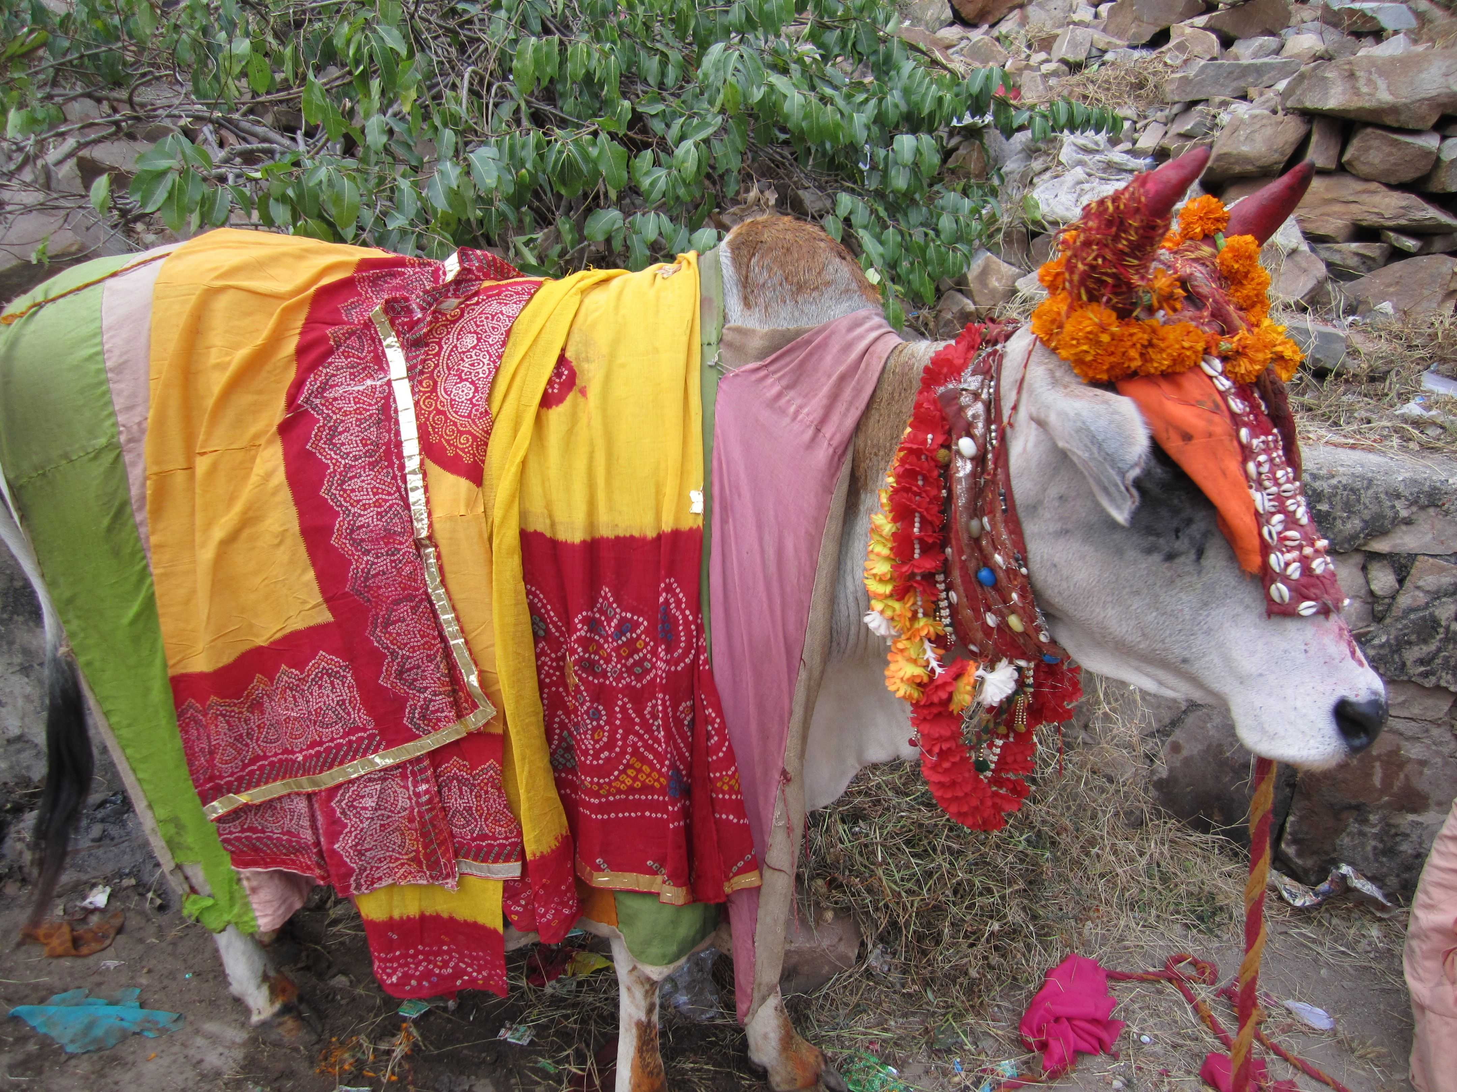
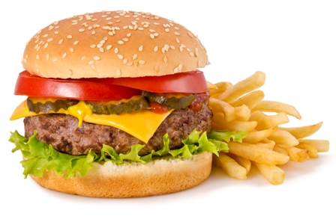
Cultural Variation
India
United states

Slide 7
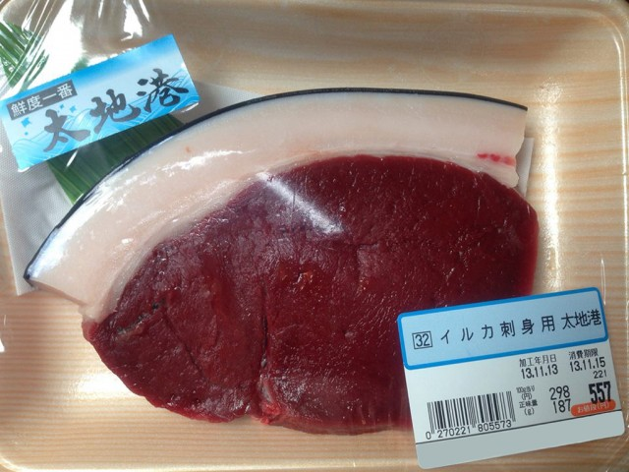

Cultural Variation
United states
Japan

Slide 8
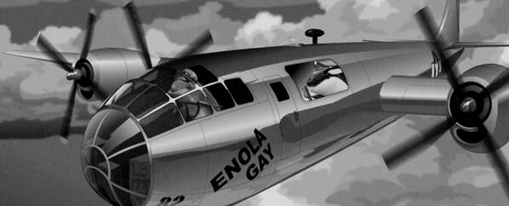
Cultural Variation
Satire

Slide 9
Cultural Variation
Subcultures
Argot
Countercultures
Culture Shock
Ethnocentrism
Cultural Relativism

Slide 10
Socialization: Learning Culture

Slide 11
The Self and Socialization
Looking-Glass Self
Stages of Self
Preparatory Stage - Symbols
Play Stage - Role Taking
Game Stage - Generalized other
Presentation of self
Impression Management
Dramaturgical Approach

Slide 12
Socialization
Learning Culture
Learning Roles
Role Strain
Role Conflict
What are the main Agents of Socialization?

Slide 13
Agents of Socialization

Slide 14
Socialization
Learning Culture
Learning Roles
Role Strain
Role Conflict
What are the main Agents of Socialization?
A look at Media
Film
Advertising

Slide 15
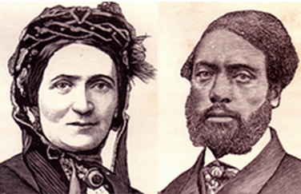
Ellen and William Craft

Slide 16
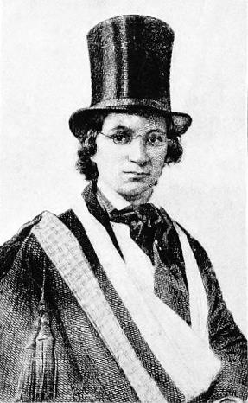
Ellen and William Craft

Slide 17
Socialization and the Life Course
Rites of Passage
Anticipatory Socialization
Resocialization
Total Institutions

Slide 18
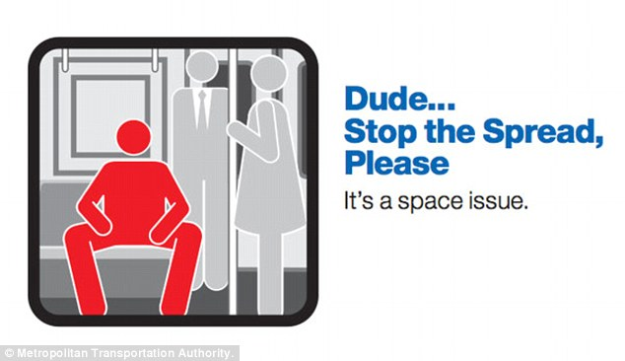
Resocialization

Slide 19
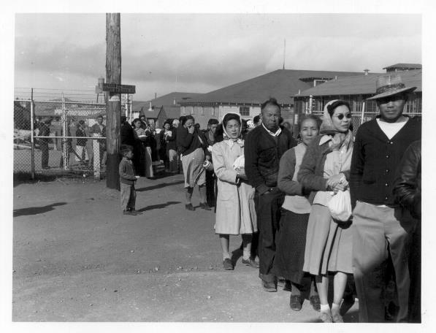
Resocialization
Total Institutions:
Interment Camps
Boot Camps
Prisons
Convents etc.

